Slide 1
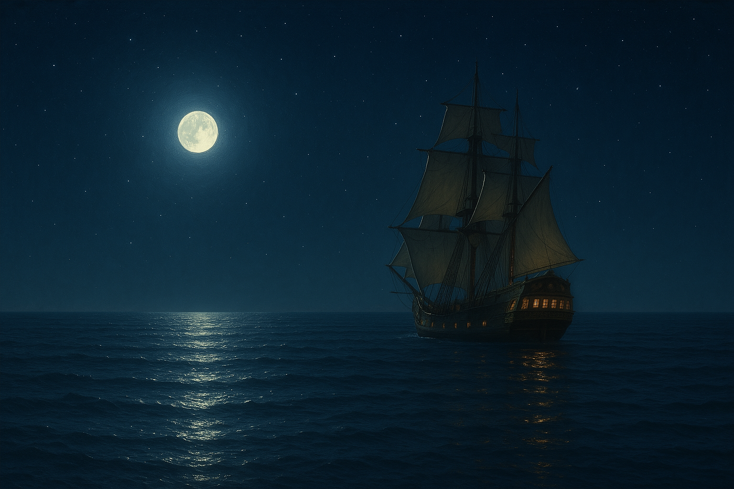
Plotting my plunders
Away from the powers-that-be
With only my manifest, lodestars and renegade crew
Plotting my plunders

Slide 2
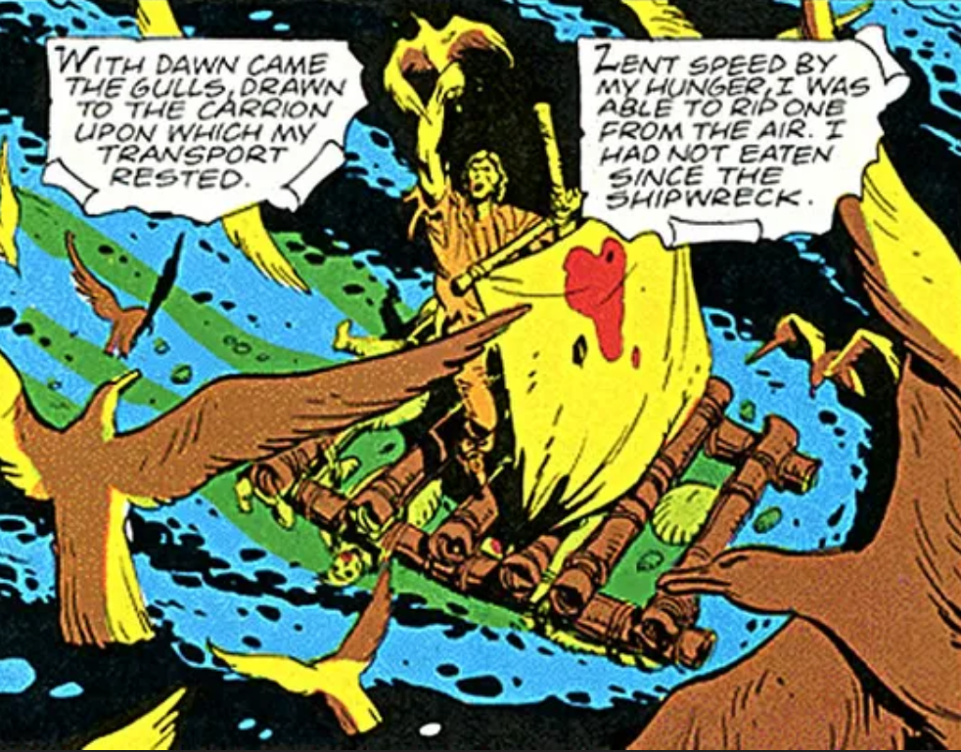
Leaving us trades instructors very much alone.
COVID uprooted our andragogy

Slide 3
I looked high . . .
. . . I looked low

Slide 4
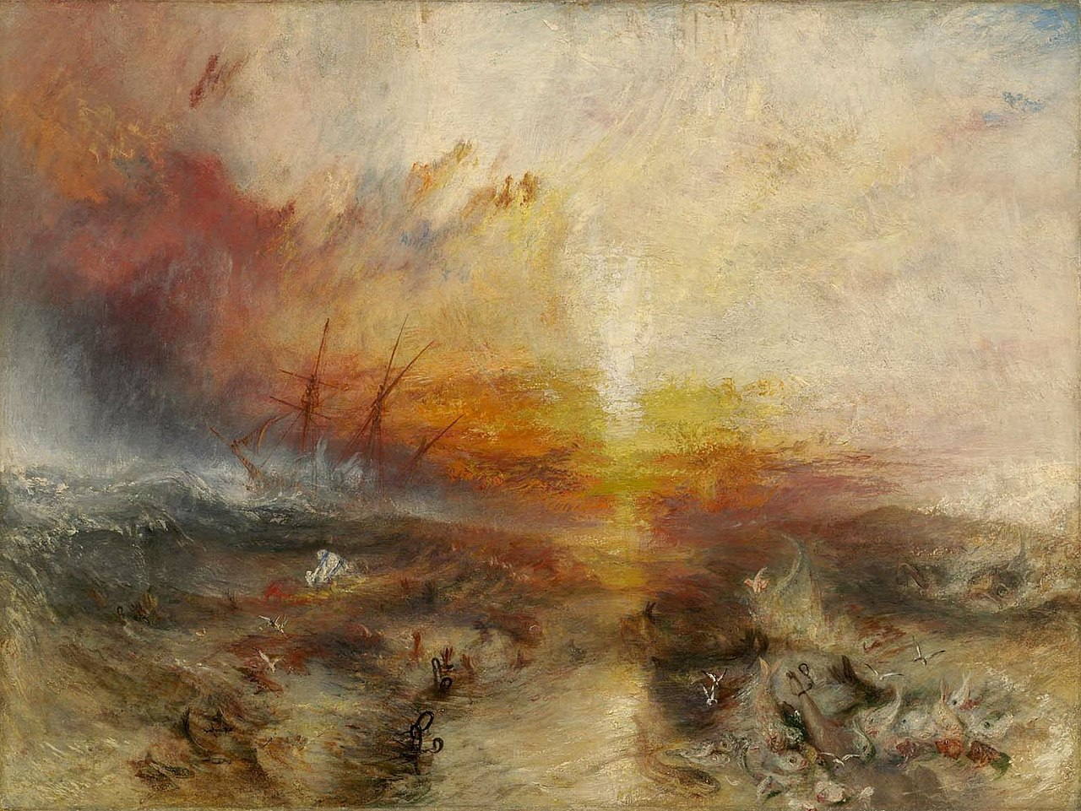
I slowly realized it was solely up to me to plot a course into …
Digital Discipline
Digital Discipline

